Slide 1
Data Mining using Matrix/Tensor Factorizations & Applications Evrim Acar Simula Metropolitan Center for Digital Engineering Oslo, Norway
TexPoint fonts used in EMF.
Read the TexPoint manual before you delete this box.: AAA

Slide 2
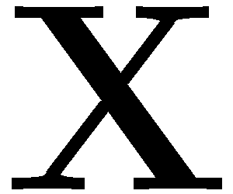

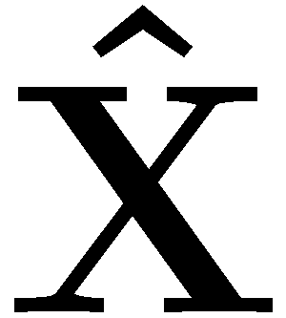
Matrix Factorizations in Data Mining
terms
topic 1
topic 2
topic R
Capturing underlying
hidden factors/patterns
+
+
…
+
≈
users
customers
…
Incomplete Matrix Factorization/
Matrix Completion
+
+
+
≈
=
movies

Slide 3
Data is often squeezed to be two-way!
2-way
Social networks : <users, keywords>
<employee, employee>
<users, users>
Text mining: < documents, terms>
Recommender
Systems: <customers, items>
Computer vision: <people, pixels>
Neuroscience: <electrodes, time>
keywords
users

Slide 4
Data is often squeezed to be two-way!
2-way
Multi-way
Social networks : <users, keywords> < users, keywords, time>
<employee, employee> < employee, employee, time>
<users, users> < users, users, communication type>
Text mining: < documents, terms> < documents, terms, terms>
Recommender
Systems: <customers, items> <customers, items, tags>
Computer vision: <people, pixels> <people, pixels, viewpoints>
Neuroscience: <electrodes, time> <electrodes, time, frequency>
<electrodes, time, subjects>
keywords
time
keywords
users
users

Slide 5
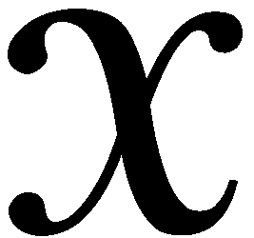
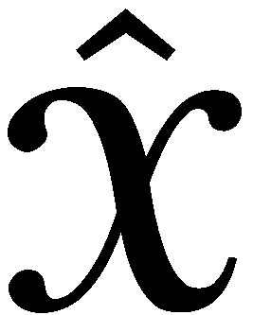
Data is often multi-way!
conversation 1
conversation 2
conversation R
Capturing underlying
hidden factors/patterns
time
…
≈
+
+
+
users
terms
locations
…
Incomplete Tensor Factorization/Tensor Completion
≈
=
+
+
+
users
activities

Slide 6





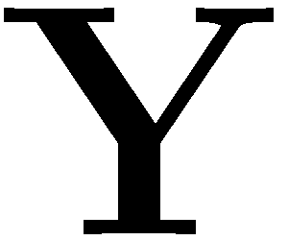

Matrix Factorizations in Data Mining
Matrix Factorizations
≈
+
+ …+
Matrix Completion
≈
+
+…+
=
Data sets are often multi-way: Tensor Factorizations
Tensor Factorizations
≈
+
+…+
Tensor Completion
≈
+
+…+
=
Data sets often come from multiple sources: Data Fusion
Coupled Matrix Factorizations
Coupled Tensor Factorizations

Slide 7
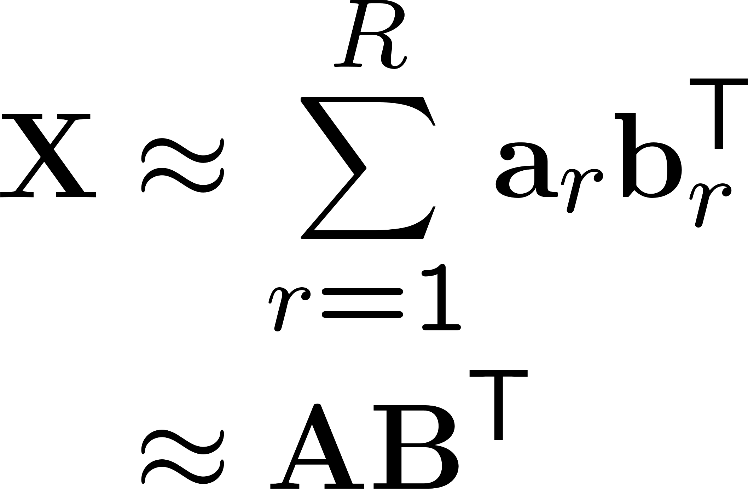
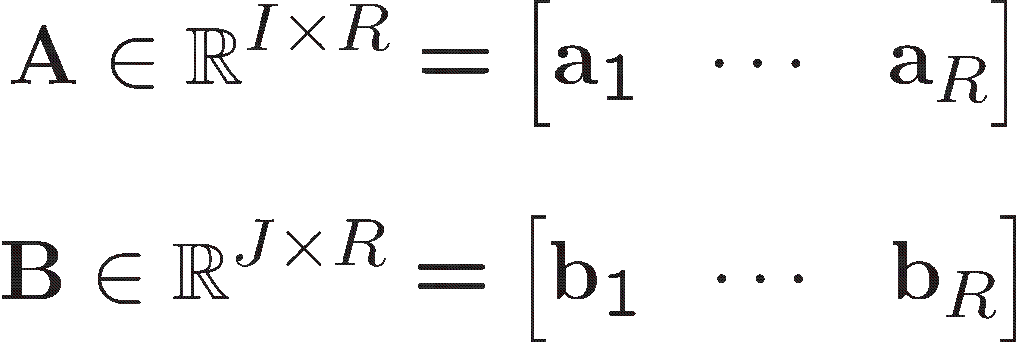
Matrix Factorizations
Matrix Factorizations, e.g., SVD (Singular Value Decomposition), NMF (Nonnegative Matrix
Factorization), are commonly used in data mining.
variables
J
R
J
B^{T}
R
≈
A
samples
I
I

Slide 8

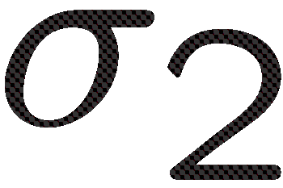

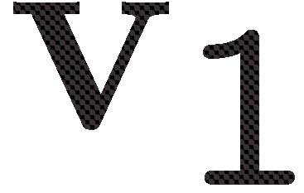
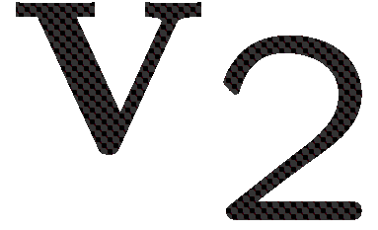




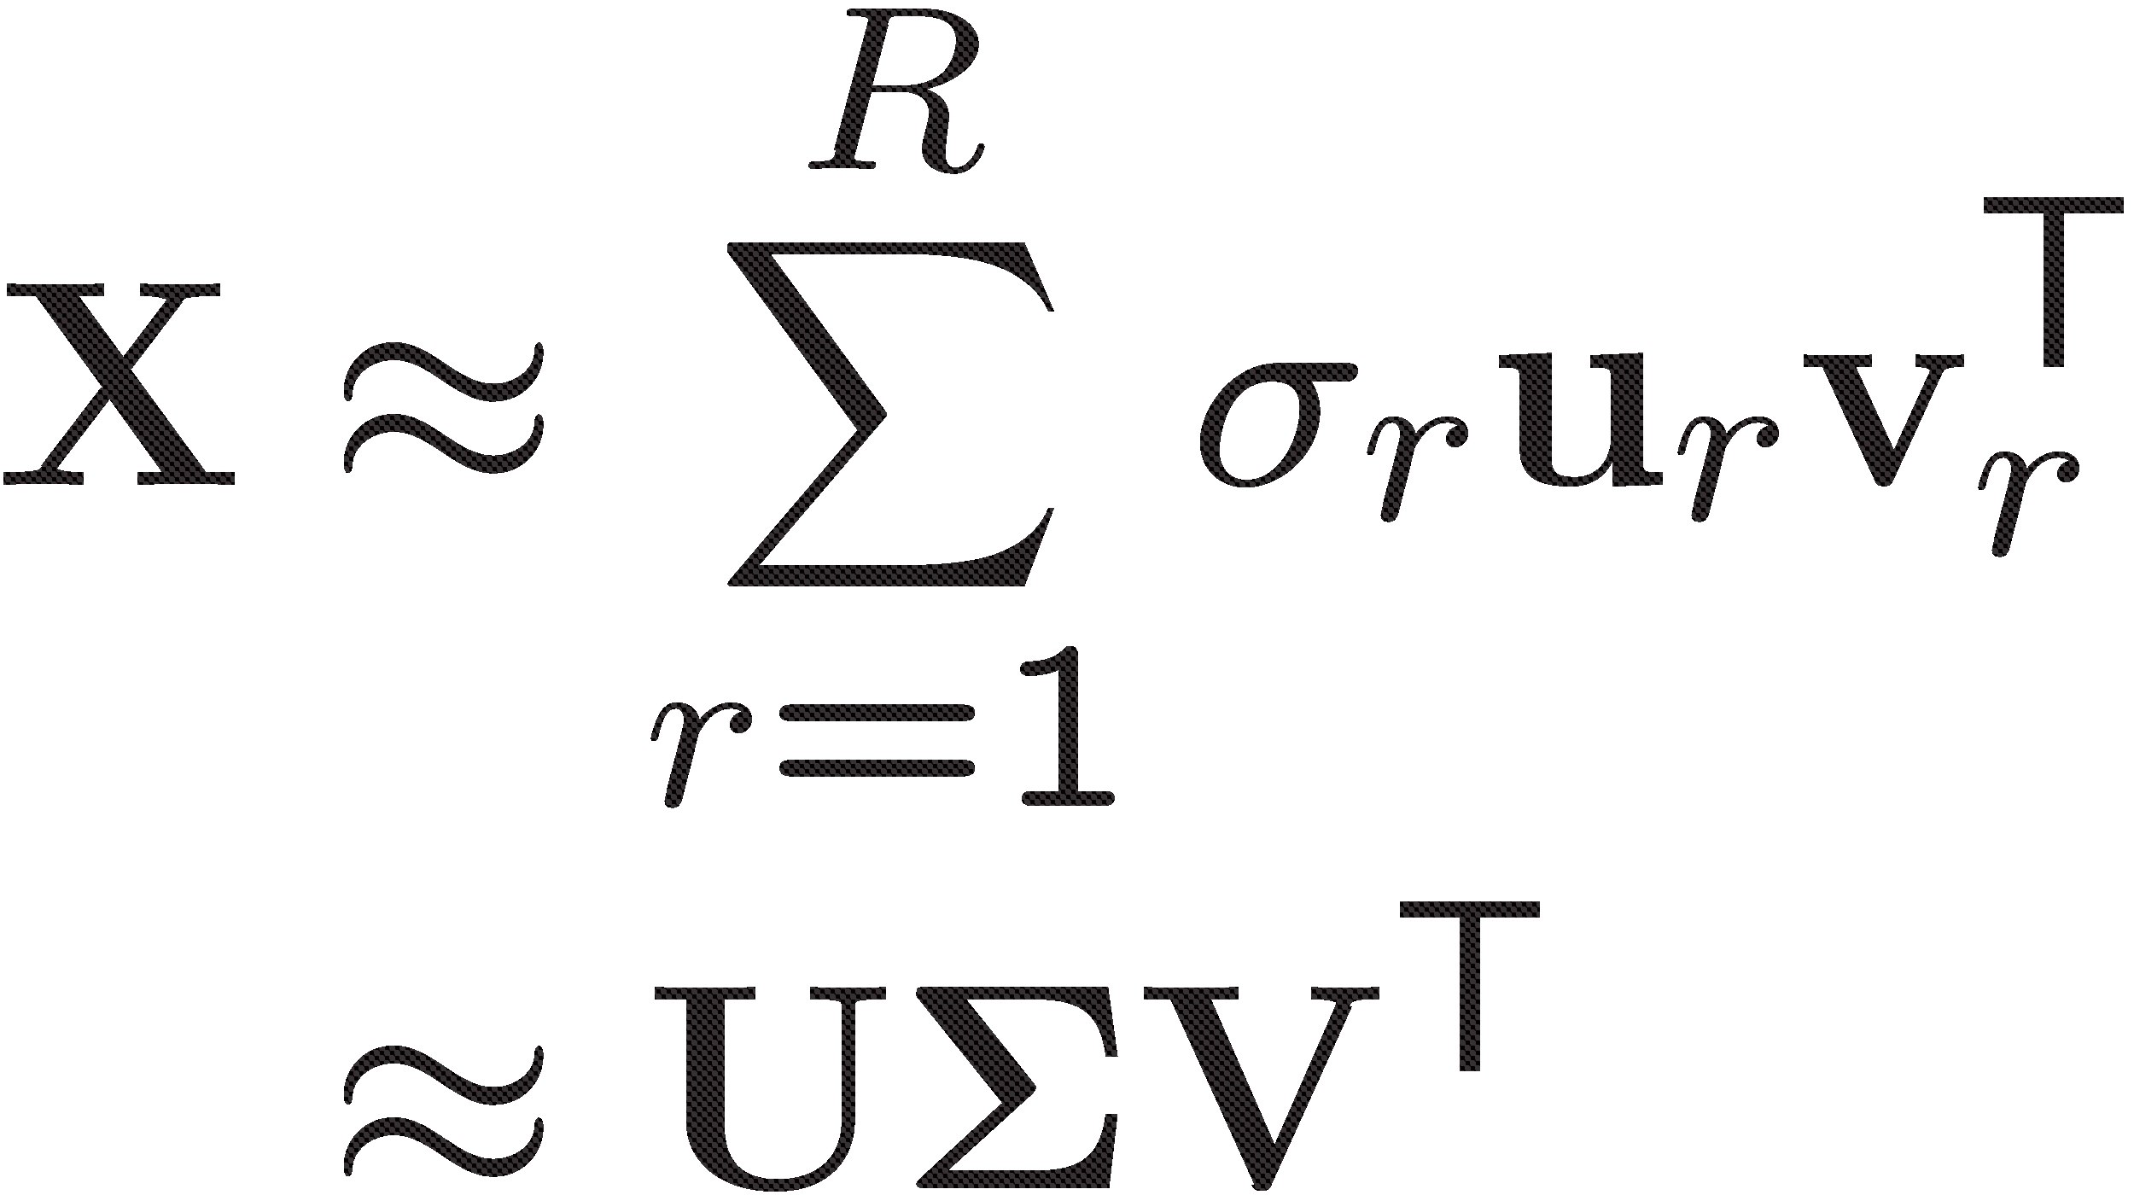
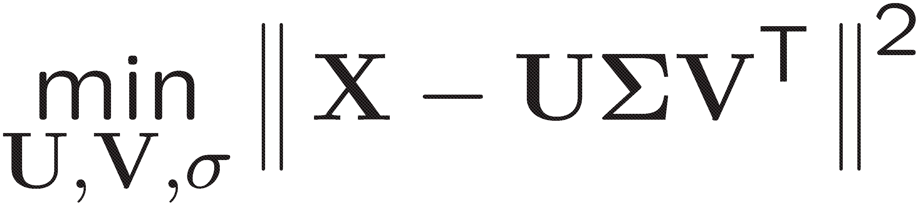
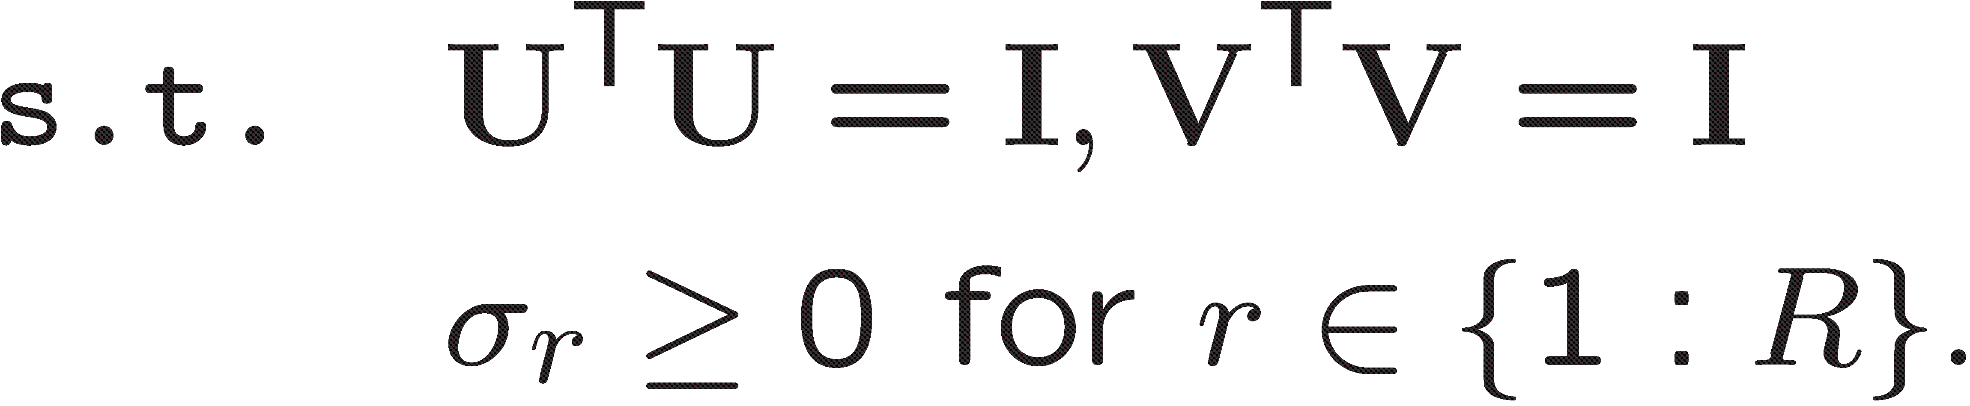
Matrix Factorizations: Finding Underlying Structures
We can use SVD to find the underlying structures in a data set. For instance, using SVD of a users
by movies matrix, we can capture the movie types and user groups.
movies
…
+
+
+
≈
users
Notes:
Rewrite this

Slide 9
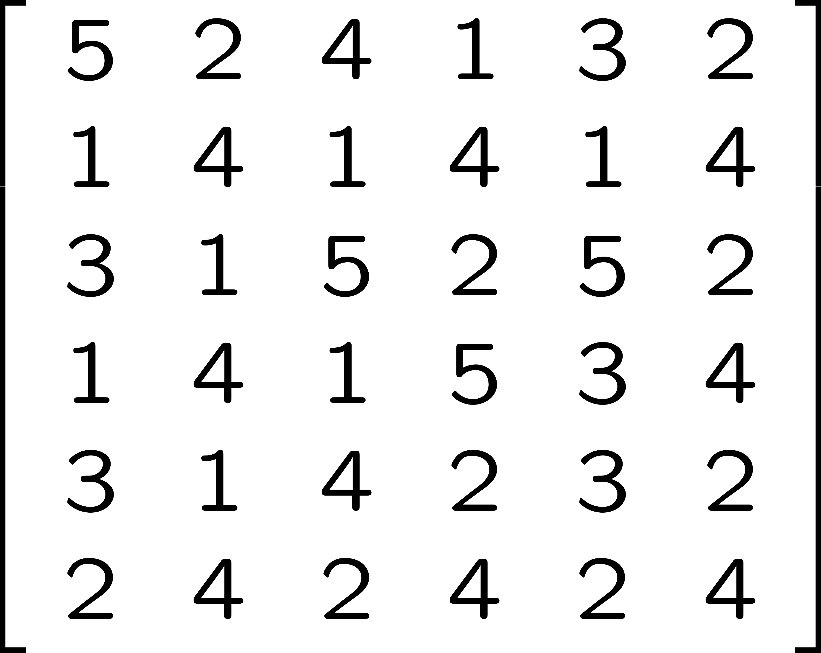
Matrix Factorizations: Finding Underlying Structures
We can use SVD to find the underlying structures in a data set. For instance, using SVD of a users
by movies matrix, we can capture the movie types and user groups.
movies
…
+
+
+
≈
users
Hunger Games
Maze Runner
American Pie
Silver Linings
Star Wars
Aloha
User 1
User 2
User 3
User 4
User 5
User 6
Who likes what type of movies?

Slide 10

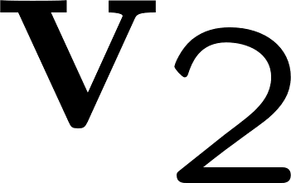

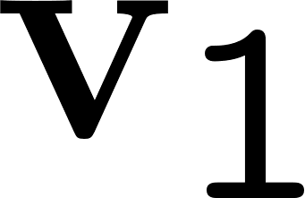
Matrix Factorizations: Finding Underlying Structures
Tool: Singular Value Decomposition
Hunger Games
Maze Runner
American Pie
Silver Linings
Star Wars
Aloha
User 1
User 2
+
≈
User 3
User 4
User 5
User 6
Romantic/comedy
Sci-Fi

Slide 11

Principal Component Analysis (PCA)
PCA is a dimension reduction method often used for exploratory analysis to find the main axes of
variation in the data.
Let X be a sample by variable matrix and centered across the samples mode, e.g., each column has
mean zero. PCA reveals scores and loadings, where columns of P show the principal component
directions and T will have the corresponding principal component scores.
variables
J
R
J
P^{T}
R
loadings
≈
T
samples
I
scores
I

Slide 12
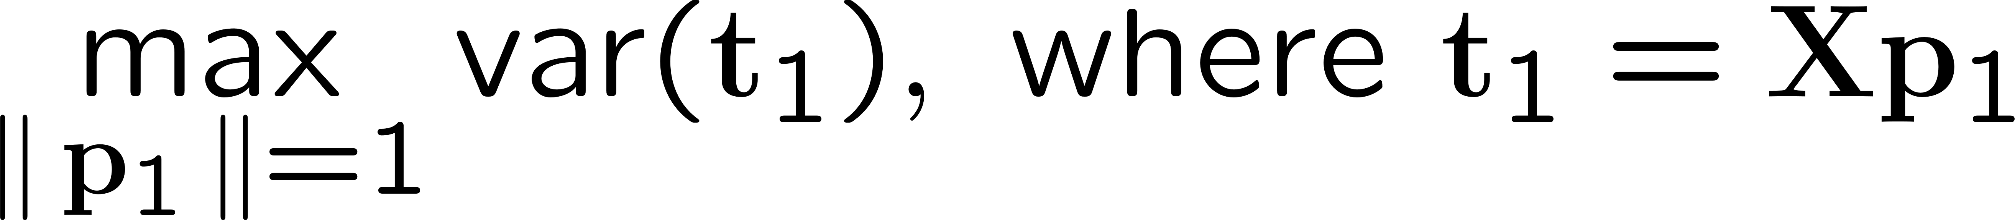
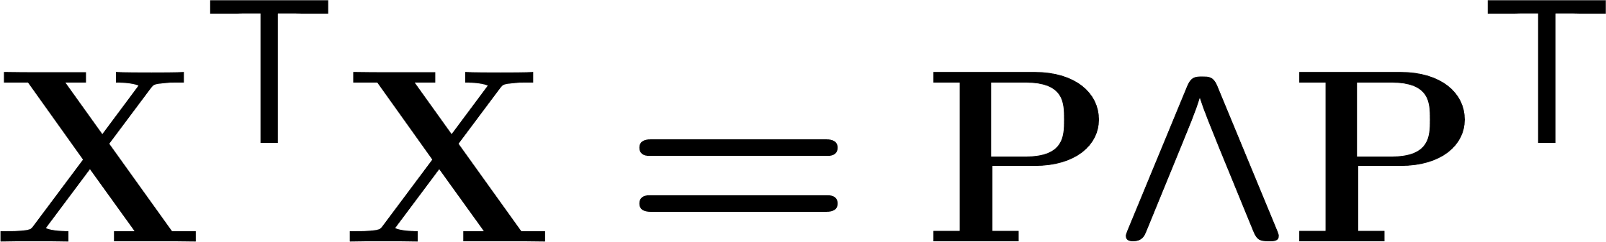
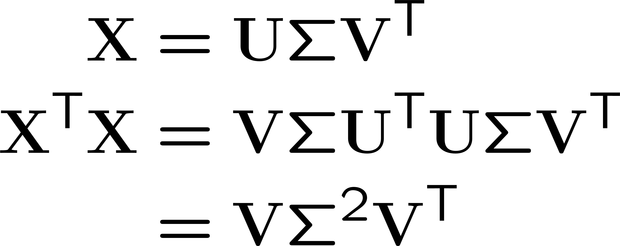
How do we find the scores and loadings?
Direction of the first principal component p₁ can be found by solving the following:
The second direction p₂ is then found in the same way with the constraint that p₁ is orthogonal to p₂
Eigenvalue decomposition of the covariance matrix gives the principal component directions.
How does this relate to SVD?
Right singular vectors are the principal component directions
The variance captured by each component is the square of the singular values

Slide 13

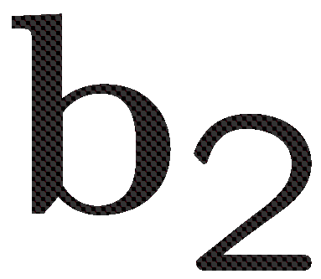


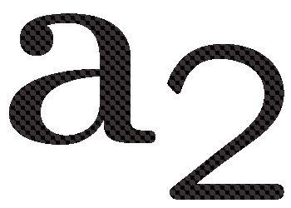

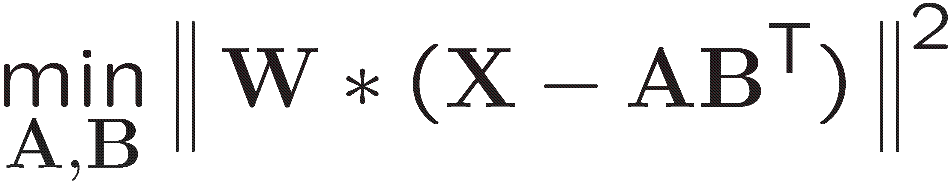
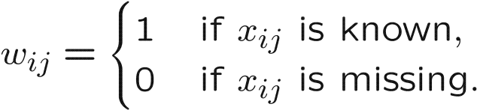

Matrix Factorizations: Missing Data Estimation (a.k.a. matrix completion)
In the case of incomplete data, matrix factorizations can be used to fill in the missing entries:
movies
…
+
+
+
≈
=
users
Finding low-rank approximation:
Data reconstruction:
It is possible to recover an unknown low-rank matrix from a nearly minimal set of entries. For more on matrix completion [Candes and Plan, 2010]

Slide 14
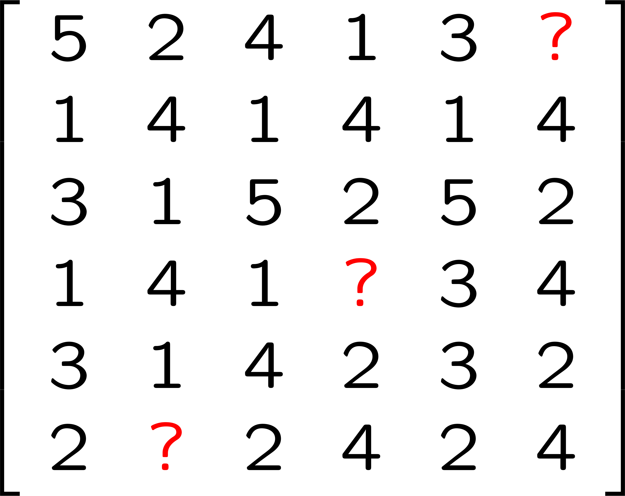
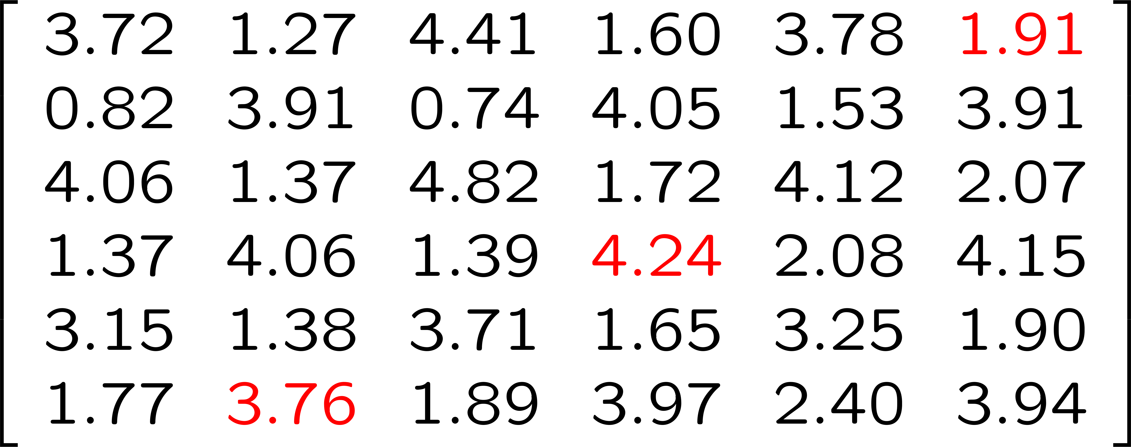
Matrix Factorizations: Missing Data Estimation
For instance, we can still factorize the incomplete X and then use those factors to reconstruct the
matrix and estimate the missing entries.
movies
≈
+
=
users
Hunger Games
Maze Runner
American Pie
Silver Linings
Star Wars
Aloha
User 1
User 2
User 3
User 4
User 5
User 6

Slide 15
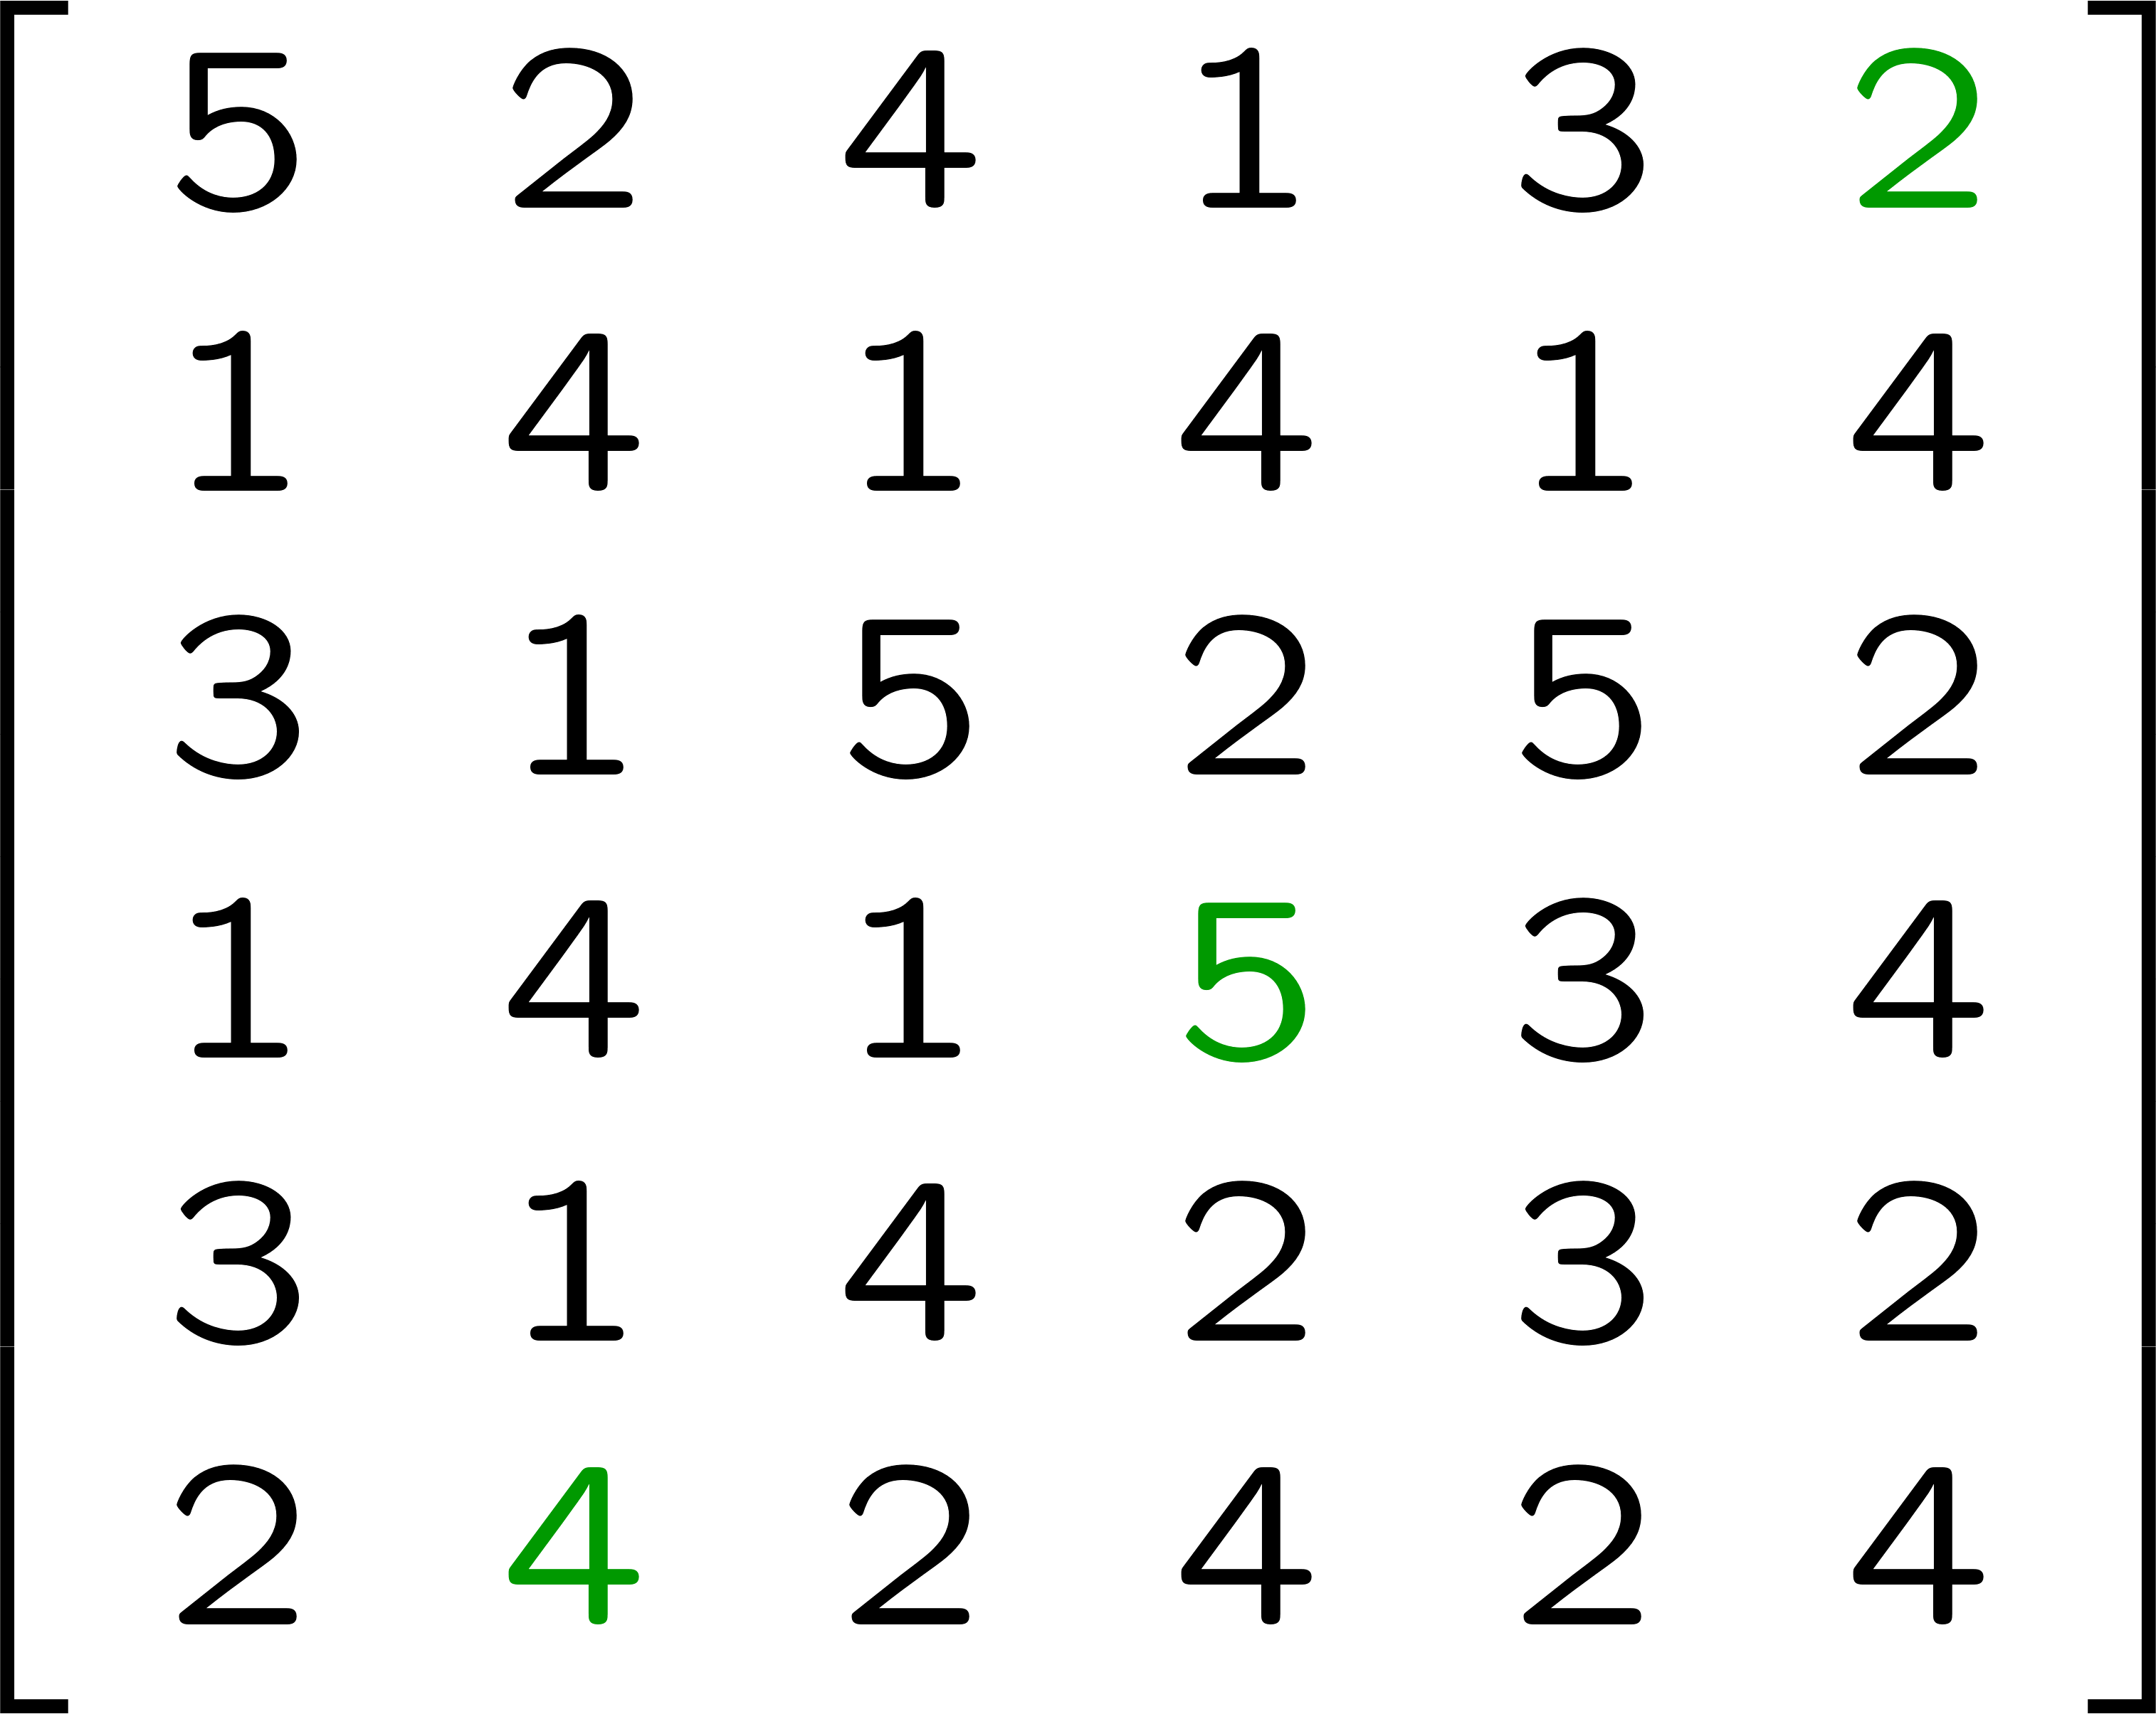
Matrix Factorizations: Missing Data Estimation
For instance, we can still factorize the incomplete X and then use those factors to reconstruct the
matrix and estimate the missing entries.
movies
≈
+
=
users
Hunger Games
Maze Runner
American Pie
Silver Linings
Star Wars
Aloha
User 1
User 2
User 3
User 4
User 5
User 6

Slide 16
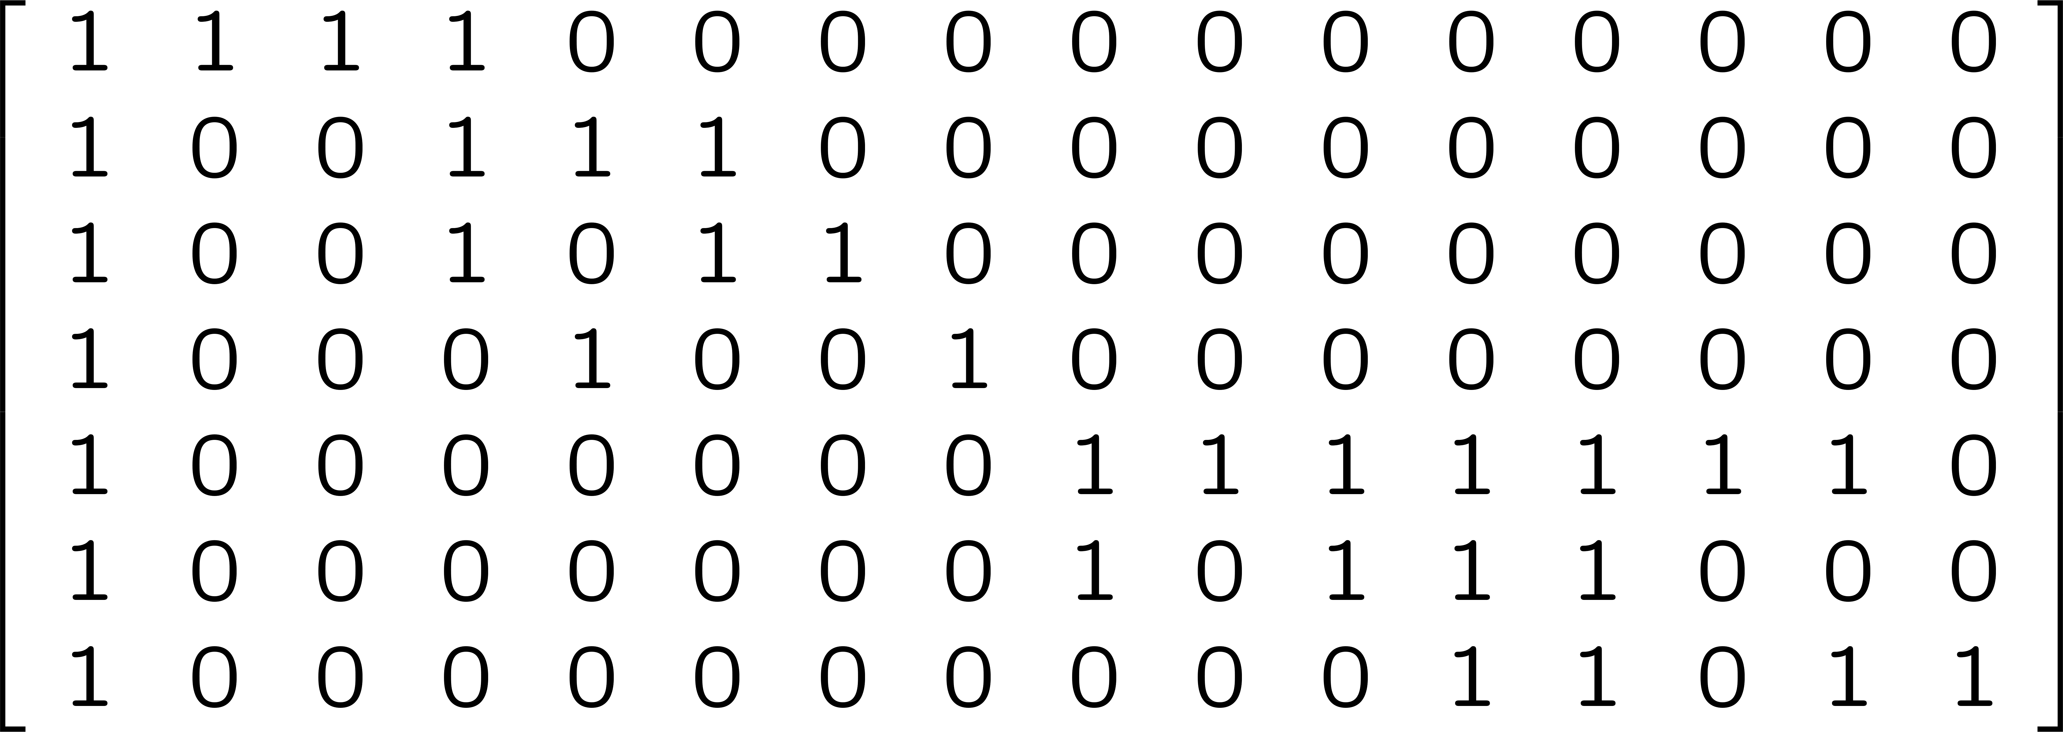
Text Mining
Suppose we have the documents with the following titles and we want to group them into topics:
Document 1: Tiger stopped playing golf
Document 2: News about Tiger and his golf career
Document 3: Golf career of Tiger in jeopardy
Document 4: Tiger and his wife in the news
Document 5: The new zoo featuring the big cat family: tigers and lions
Document 6: Tigers – the big cats – in the new zoo
Document 7: Tigers and lions, which are the biggest cats?
jeopardy
featuring
wife
family
lions
career
cat
which
play
news
big
tiger
stop
golf
zoo
new
Doc1
Doc2
Doc3
Doc4
Doc5
Doc6
Doc7

Slide 17
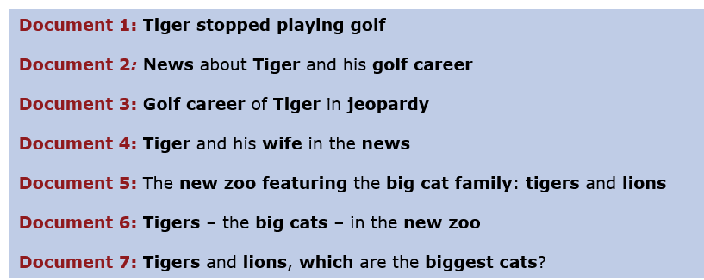
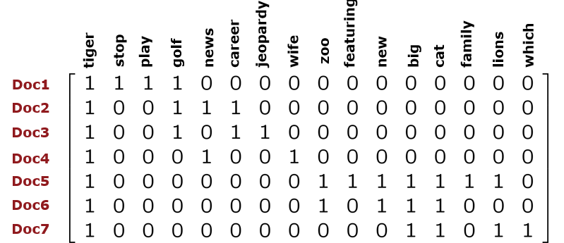
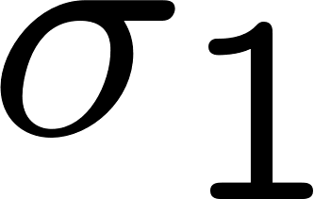
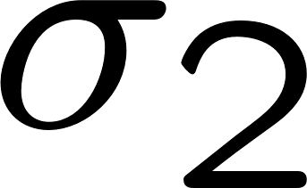
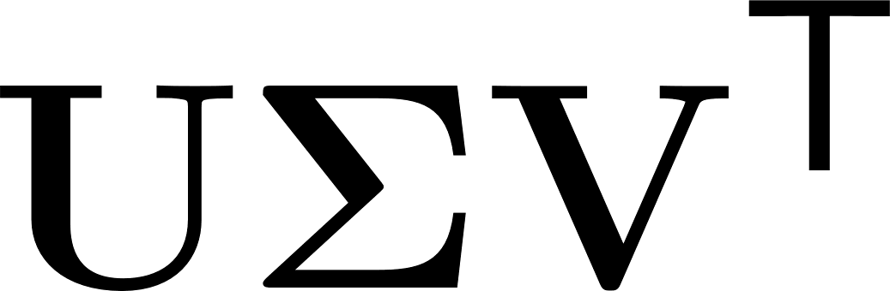
Text Mining (cont.)
≈
+
=
You may be interested in:
Clustering
Document classification

Slide 18
Text Mining (cont.)
≈
+
Document 8: Tiger back to golf
You may be interested in:
Clustering
Document classification

Slide 19
Text Mining (cont.)
Tool: Singular Value Decomposition
≈
+
Document 8: Tiger back to golf
You may be interested in:
Clustering
Document classification

Slide 20
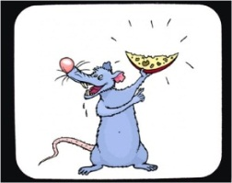
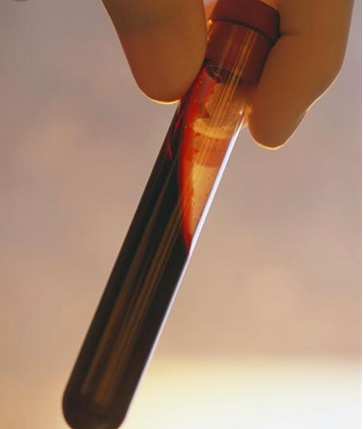
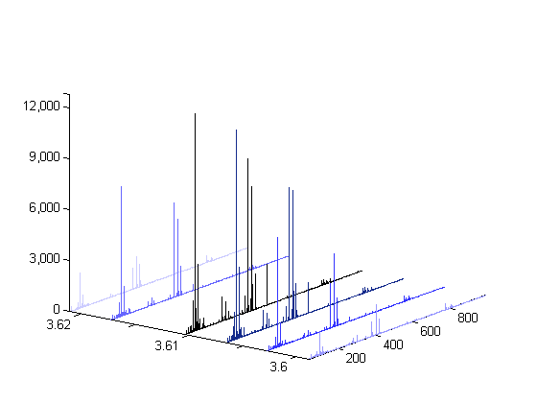

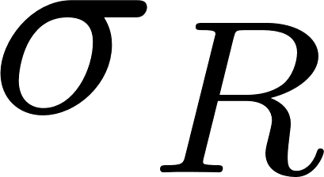
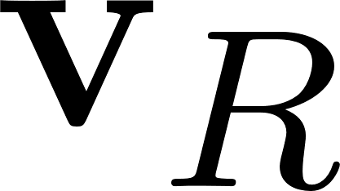
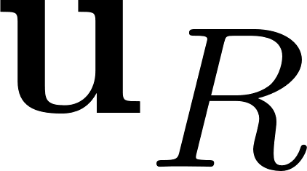
Metabolomics
The goal is to detect a wide range of metabolites in biological samples, e.g., blood or urine, and to discover the significant metabolic biomarkers related to certain conditions such as food intake or various diseases.
Some are fed with 10g apple while
some are controls (no apple)
Liquid Chromatography-
Mass Spectrometry (LC-MS)
features
samples
=
+
+
…
+
≈

Slide 21


Metabolomics
Tool: Singular Value Decomposition
The goal is to detect a wide range of metabolites in biological samples, e.g., blood or urine, and to discover the significant metabolic biomarkers related to certain conditions such as food intake or various diseases.
Some are fed with 10g apple while
some are controls (no apple)
Liquid Chromatography-
Mass Spectrometry (LC-MS)
features
samples
=
You may then check the corresponding columns in V to discover the metabolites

Slide 22
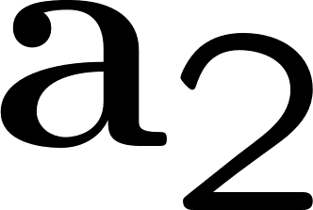
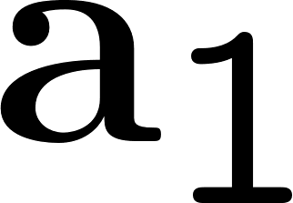
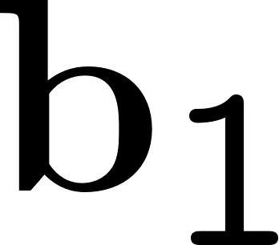
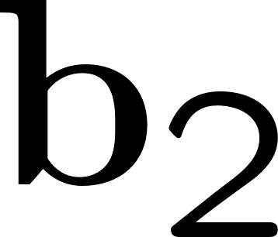
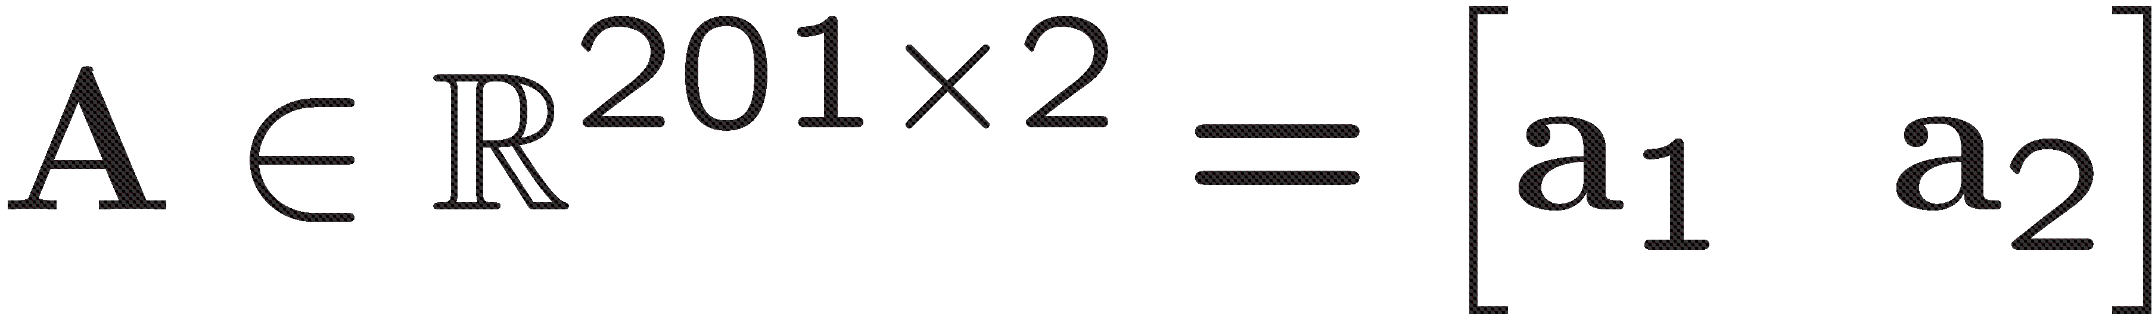
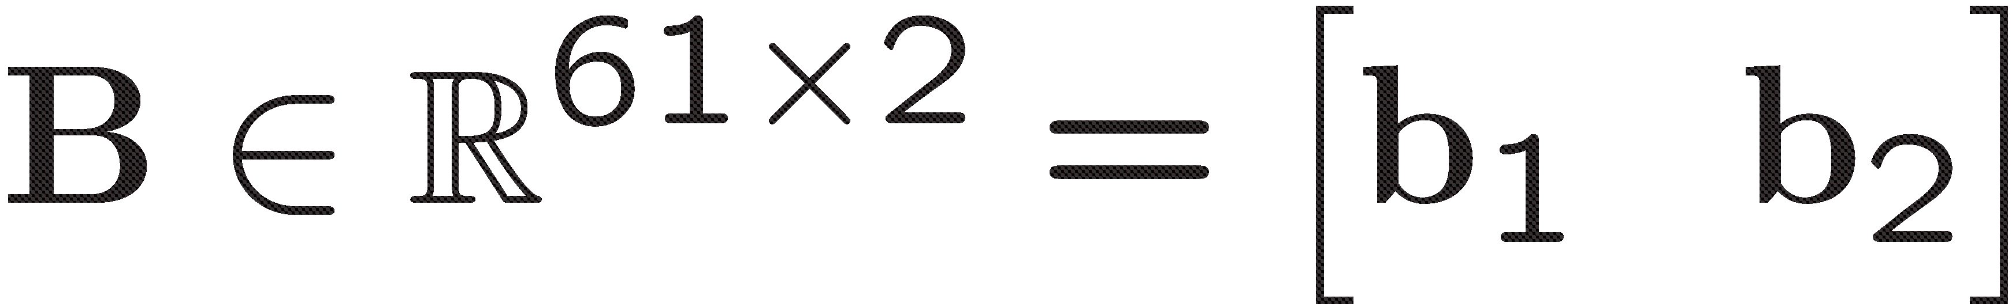

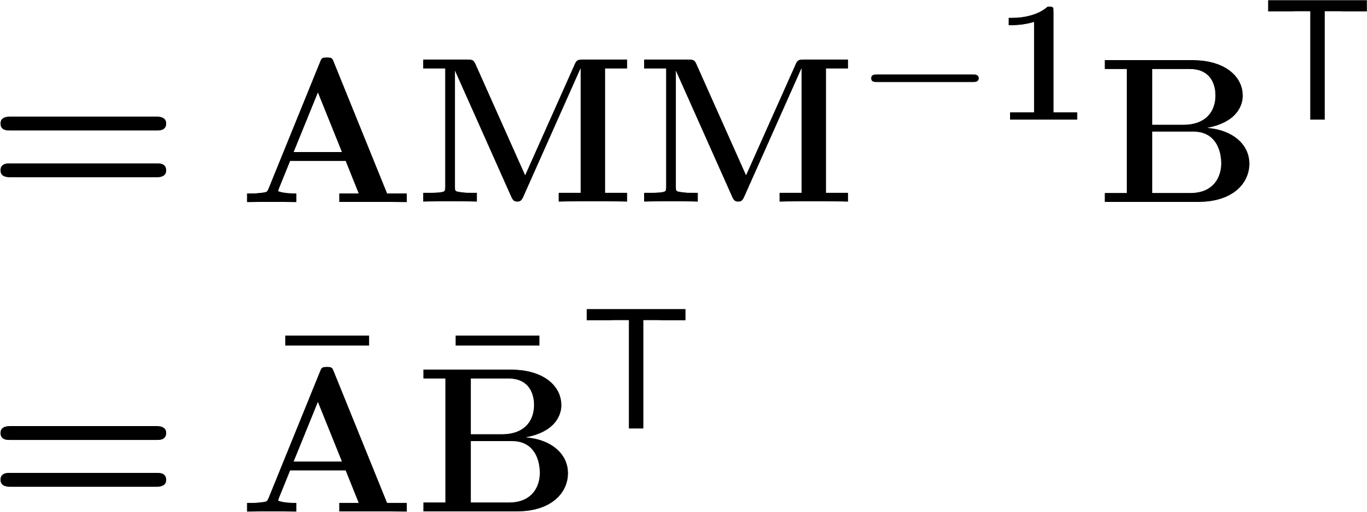
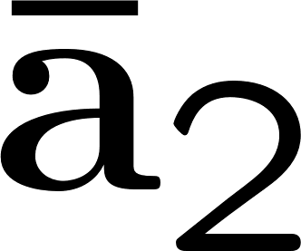
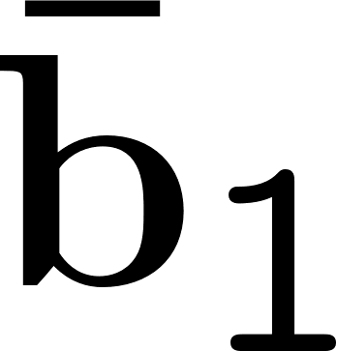
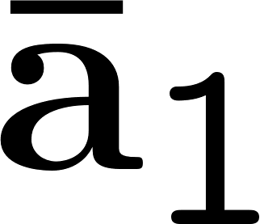
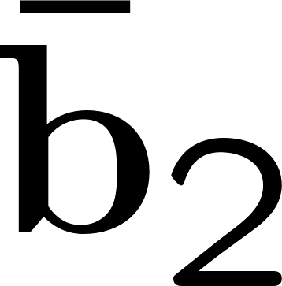
Matrix factorizations are not unique!

Slide 23


Uniqueness is an issue
Constraints are used to deal with the uniqueness problem, e.g., SVD. However, factorizations with
constraints may not be meaningful in terms of the application.
True factors
SVD captures…
Data matrix
Given X, can we recover the true factors?

Slide 24
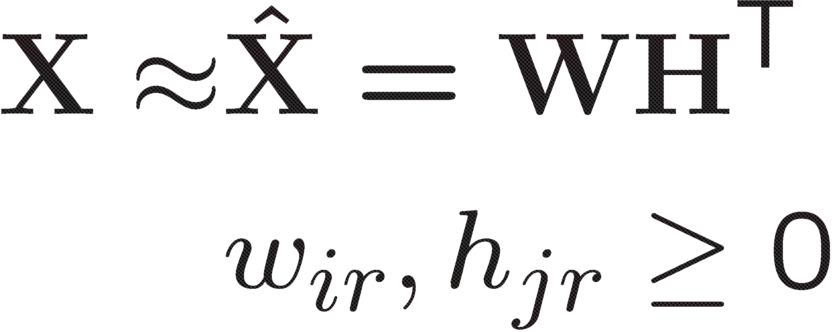




Uniqueness is an issue
Constraints are used to deal with the uniqueness problem, e.g., SVD. However, factorizations with
constraints may not be meaningful in terms of the application.
True factors
NMF captures…
Data matrix
Given X, can we recover the true factors?

Slide 25

Uniqueness is an issue
Constraints are used to deal with the uniqueness problem, e.g., SVD. However, factorizations with
constraints may not be meaningful in terms of the application.
True factors
NMF captures…
Data matrix
Given X, can we recover the true factors?

Slide 26


What if we have multiple matrices with the same underlying factors
but in different proportions…
True factors
We can recover the true factors uniquely up to trivial
indeterminacies, i.e., scaling and permutation.

Slide 27













A popular tensor factorization model: CP
Canonical Polyadic (CP)
CANDECOMP/PARAFAC (CP)
Hitchcock, 1927: Polyadic form of a tensor
Harshman, 1970: Parallel Factor Analysis (PARAFAC)
Carroll & Chang, 1970: Canonical Decomposition (CANDECOMP)
As an extension of matrix factorizations to higher-order tensors (multi-way arrays), tensor
factorizations are used to extract the underlying factors in higher-order data sets. The CP model
represents a tensor as a sum of rank-one tensors:
…
≈
+
+
+
I
K
J
CP is unique up to scaling and permutation under the condition that
where krank (A) = max. value of k such that any k columns of A is linearly independent.
[Kruskal, 1977;
Sidiropoulos and Bro, 2000]

Slide 28



Neuroscience: CP has proved useful in epileptic seizure localization
[Acar et al., 2007; De Vos et al., 2007]
Tool: Tensor Factorizations
CWT
time
time
channels
archlab.gmu.edu
channels
frequency
Eye artifact
time
frequency
channels
≈
+
time
time
frequency
channels
channels
Seizure
frequency

Slide 29









Recommender Systems: CP can capture temporal patterns useful for link prediction
Tool: Tensor Factorizations
[Dunlavy, Kolda, Acar, 2011]
Temporal Link Prediction
Which customers will buy which products?
Which webpages will users visit?
T
T+1
years
…
T+1
2
1
+
≈
authors
+
conferences

Slide 30



Chemometrics: CP can separate the chemicals in mixtures
[Andersen and Bro, 2003]
A popular application of the CP model is the separation of individual chemicals from mixtures of
chemicals measured using fluorescence spectroscopy.
≈
+
+
mixtures
excitation
emission
Amino Acid Data
http://www.models.life.ku.dk/

Slide 31
Chemometrics: CP can separate the chemicals in mixtures
Tool: Tensor Factorizations
[Andersen and Bro, 2003]
A popular application of the CP model is the separation of individual chemicals from mixtures of
chemicals measured using fluorescence spectroscopy.
≈
+
+
mixtures
excitation
emission
Amino Acid Data
http://www.models.life.ku.dk/
≈
+
+

Slide 32
Summary
≈
+
+ …+
Matrix Factorizations: How to use matrix factorizations to
find the underlying factors,
predict missing entries
Matrix factorizations without constraints are not unique.
Constraints need to make sense in terms of the application; otherwise, the model will not reveal what we are looking for.
Tensor Factorizations
Tensor factorization methods such as CP have better uniqueness properties compared to matrix factorizations.
How to use tensor factorizations, in particular, CP, to find the underlying factors, e.g., chemometrics, neuroscience, temporal link prediction
≈
+
+…+
Details, algorithms and more
applications tomorrow!

